Slide 1

Wikileaks

Slide 2
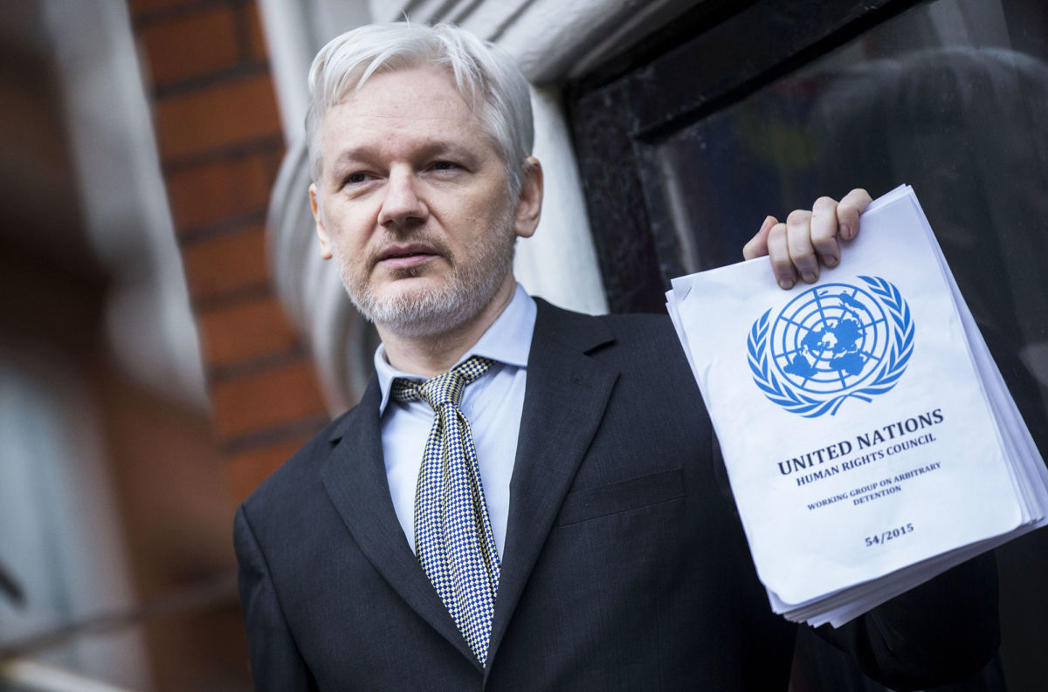
“WikiLeaks is a giant library of the world’s most persecuted documents. We give asylum to these documents, we analyze them, we promote them and we obtain more.” - Julian Assange

Slide 3
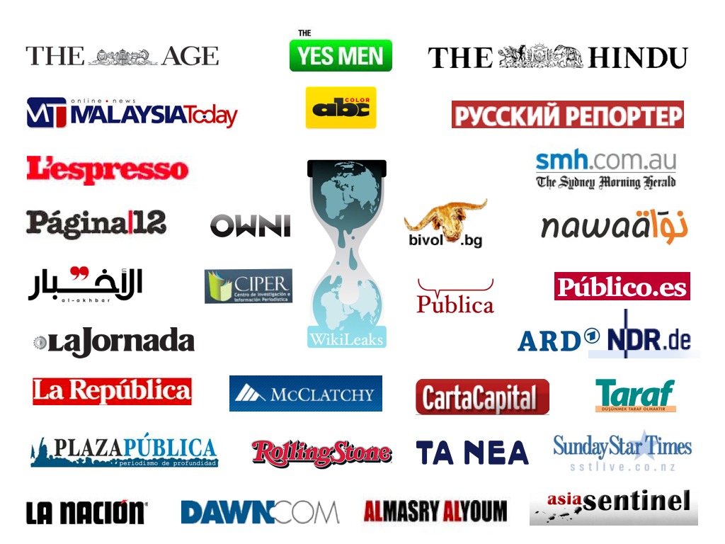
Connections

Slide 4
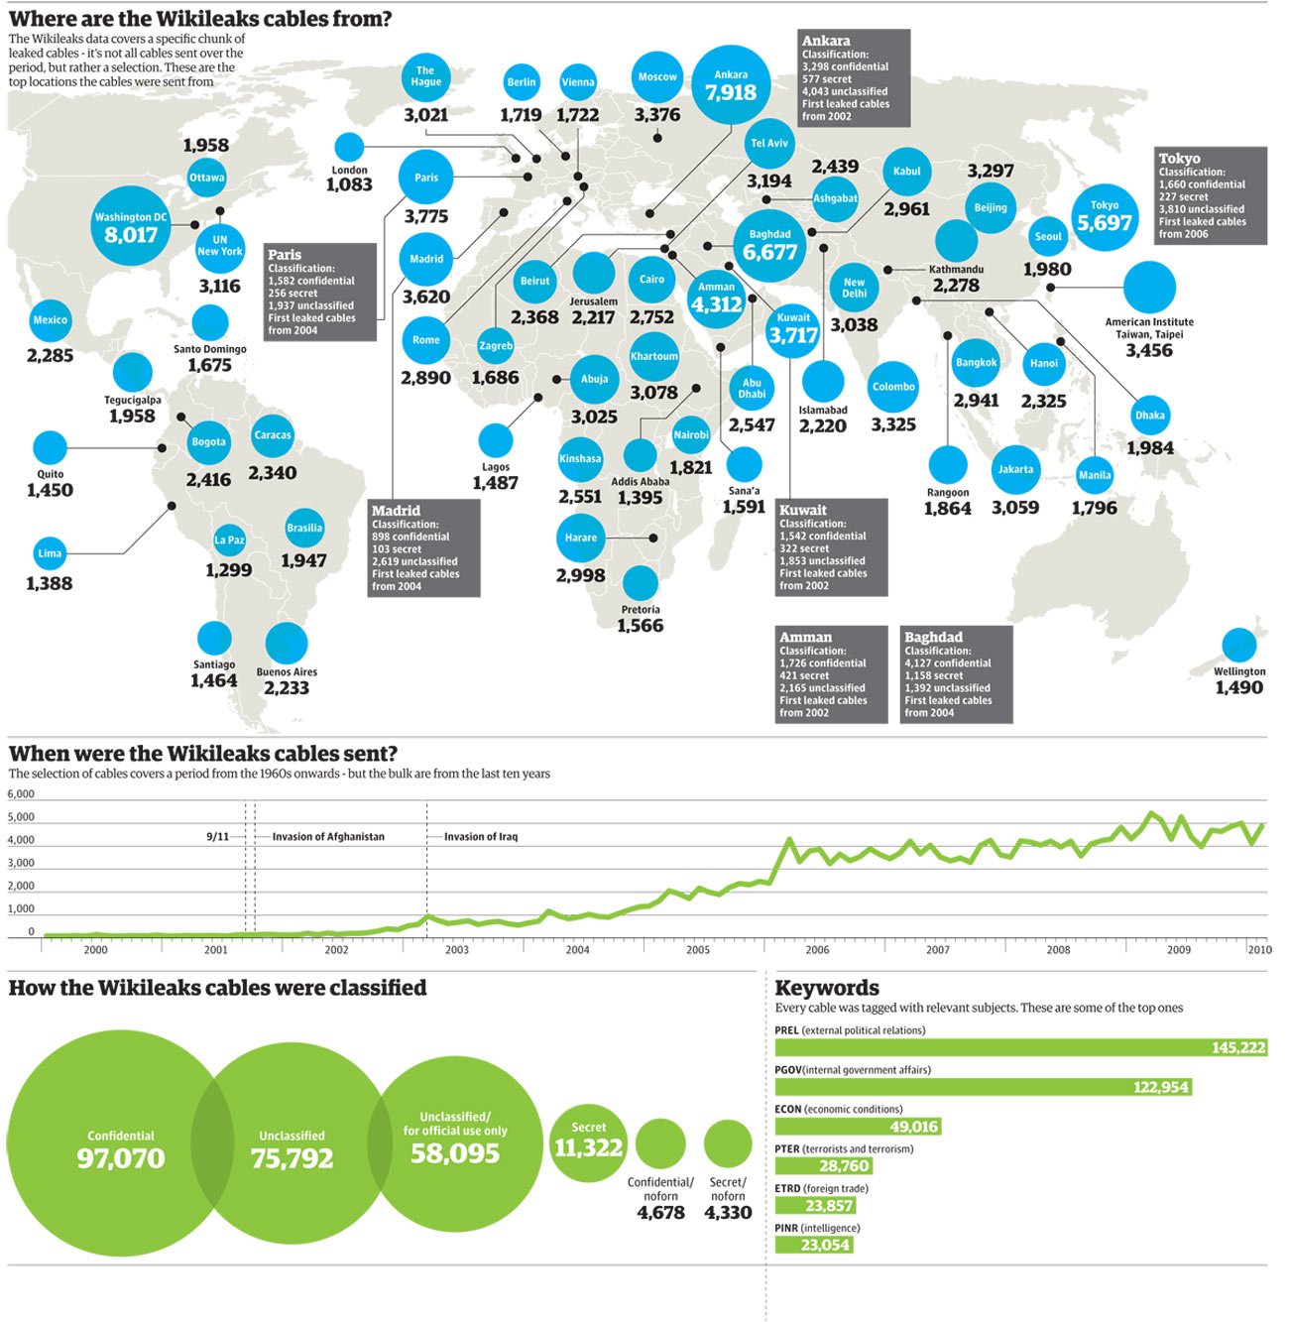

Slide 5
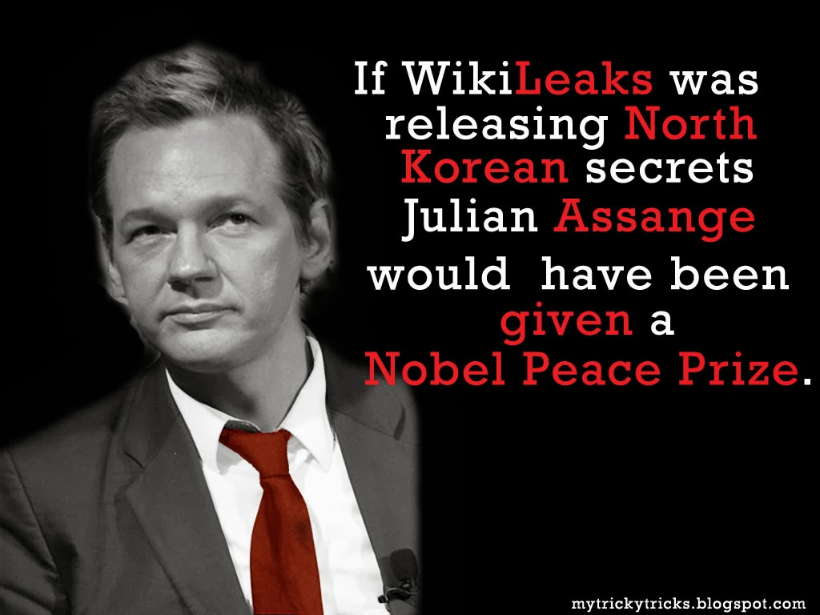
The Voltaire Award for Free Speech (2011)
The International Piero Passetti Journalism Prize of the National Union of Italian Journalists (2011)
The Jose Couso Press Freedom Award (2011)
The Privacy International Hero of Privacy (2012)
The Global Exchange Human Rights People’s Choice Award (2013)
The Yoko Ono Lennon Courage Award for the Arts (2013)
The Kazakstan Union of Journalists Top Prize (2014)
The Economist New Media Award (2008)
The Amnesty New Media Award (2009)
TIME Magazine Person of the Year, People’s Choice (highest global vote) (2010)
The Sam Adams Award for Integrity (2010)
The National Union of Journalists Journalist of the Year (Hrafnsson) (2011)
The Sydney Peace Foundation Gold Medal (2011)
The Martha Gellhorn Prize for Journalism (2011)
The Blanquerna Award for Best Communicator (2011)
The Walkley Award for Most Outstanding Contribution to Journalism (2011)
The Brazillian Press Association Human Rights Award (2013)
The Kazakstan Union of Journalists Top Prize (2014)

Slide 6
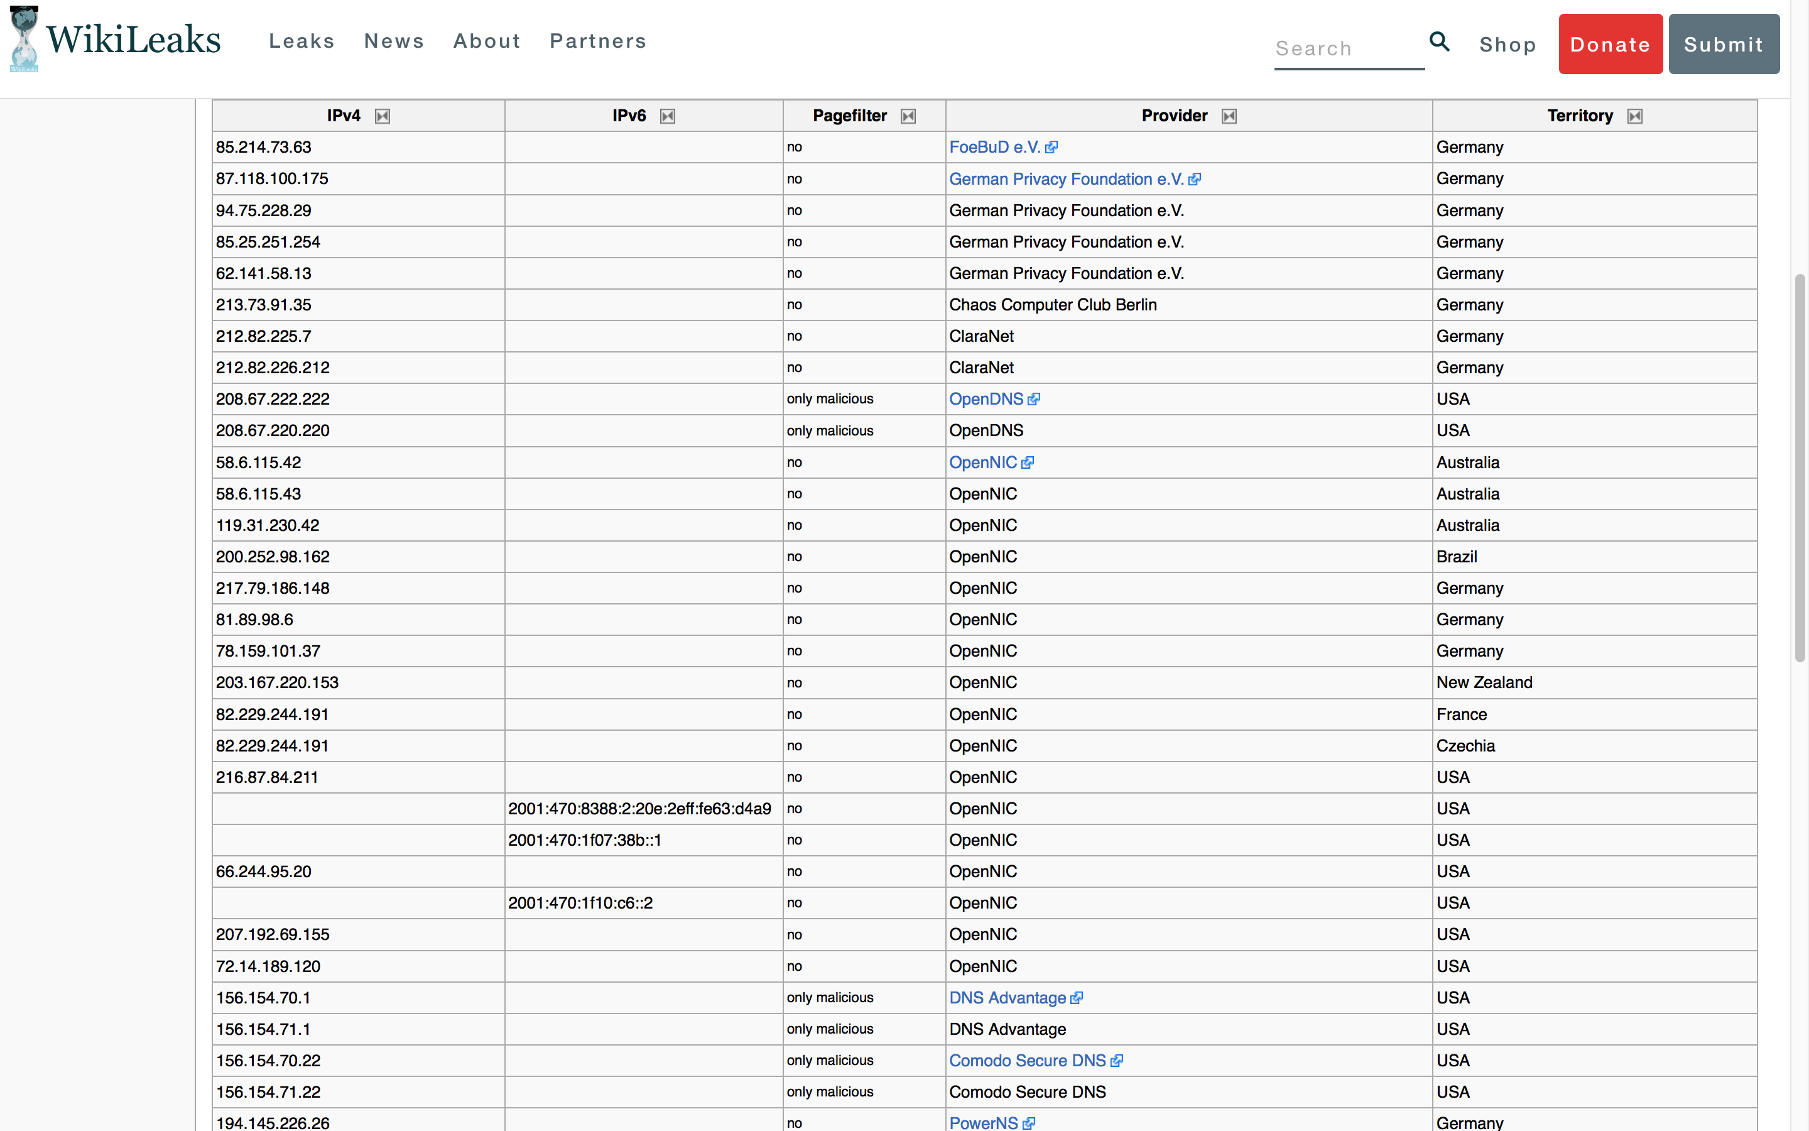
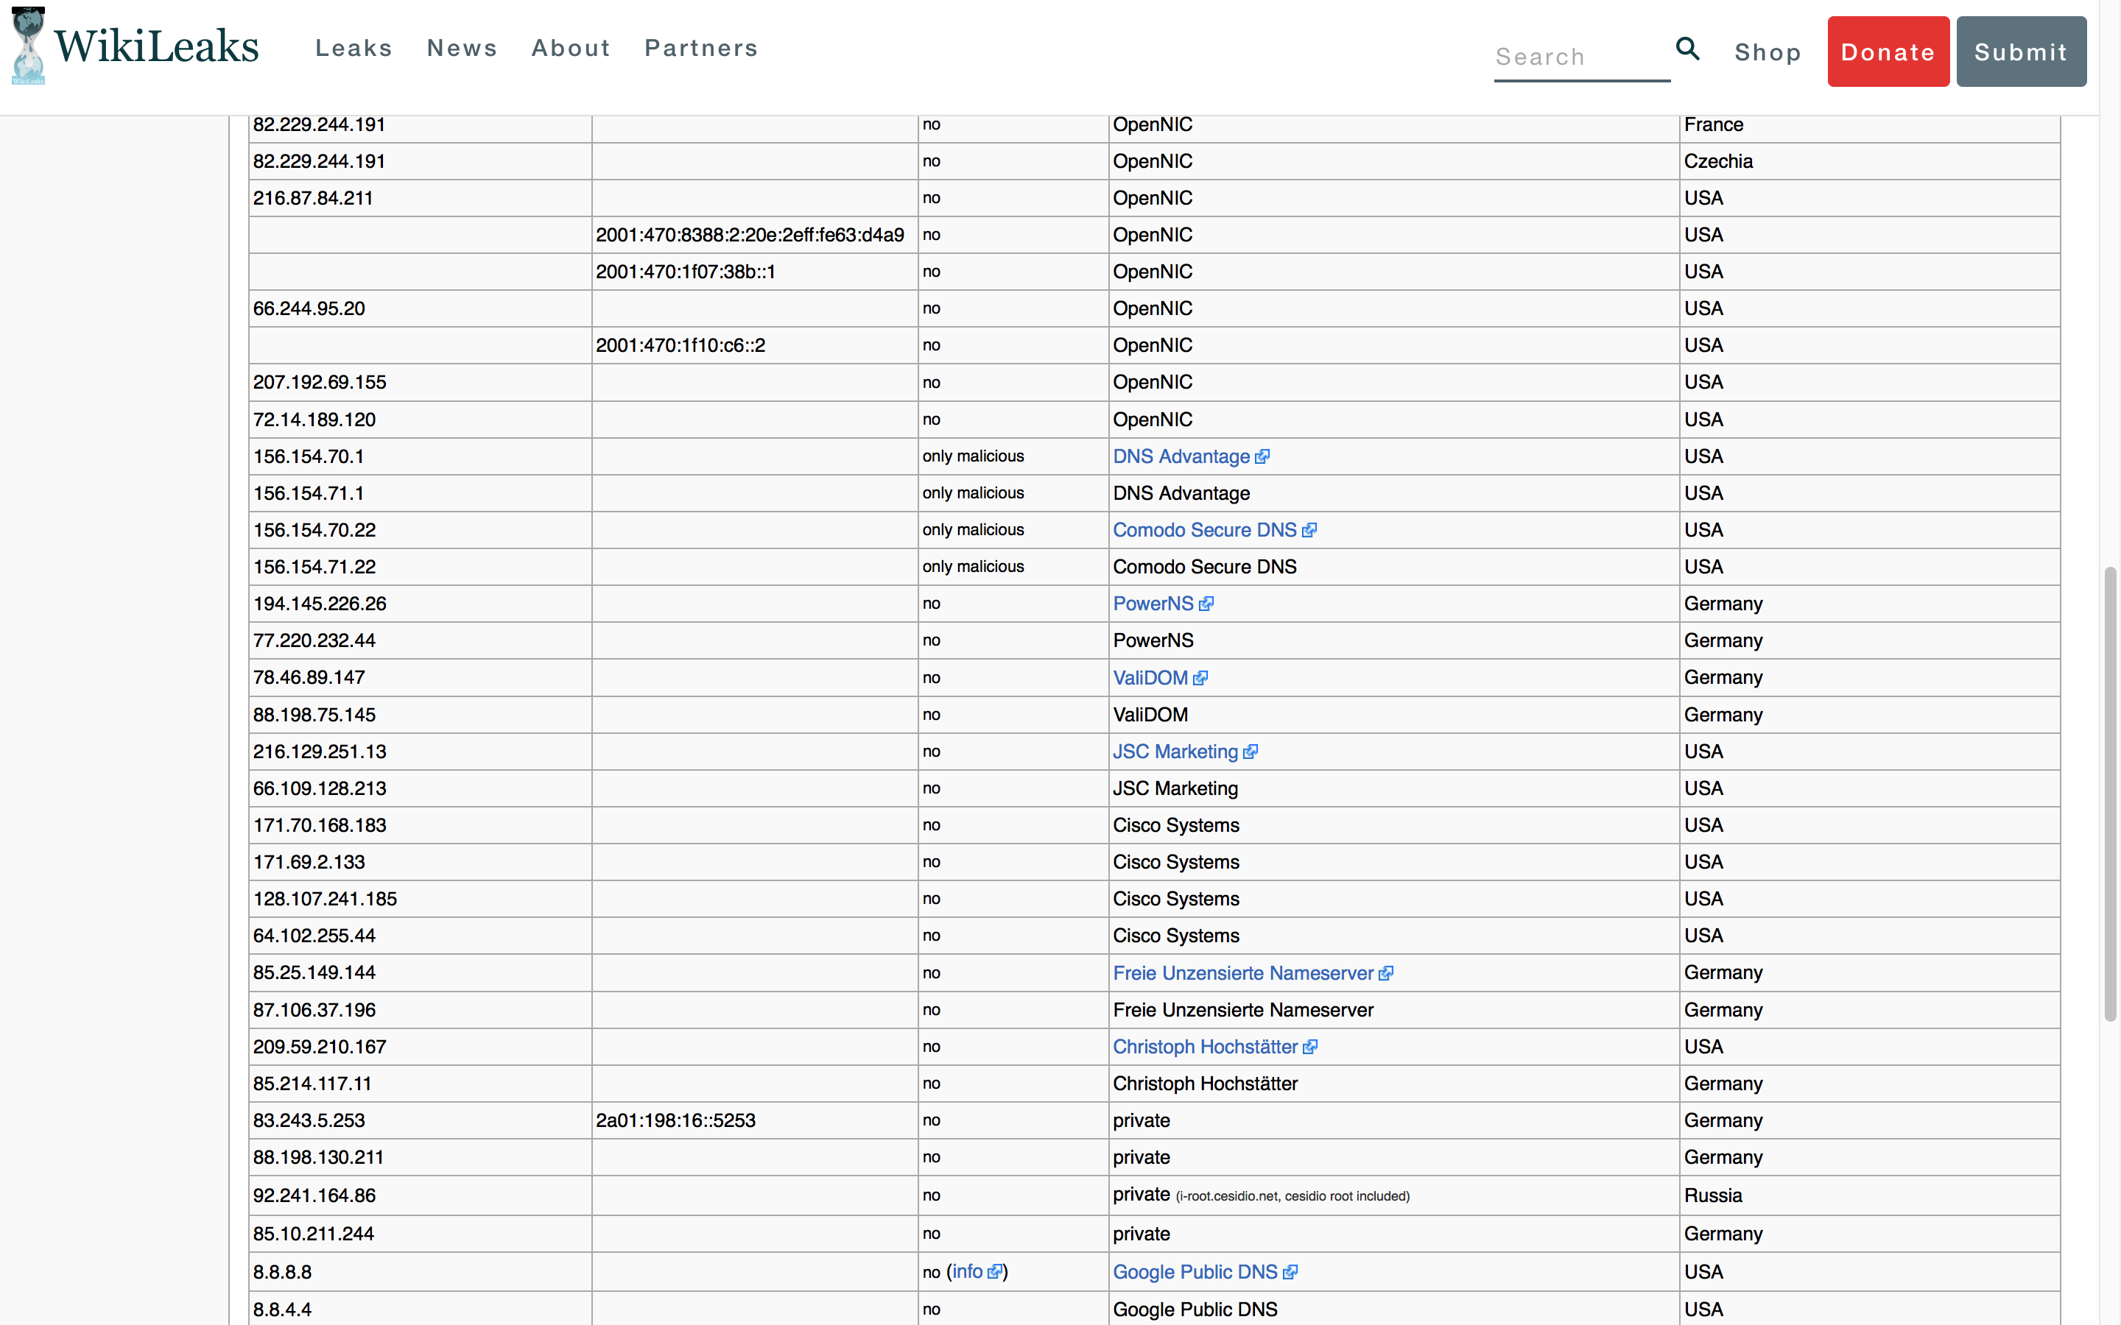
Operations

Slide 7
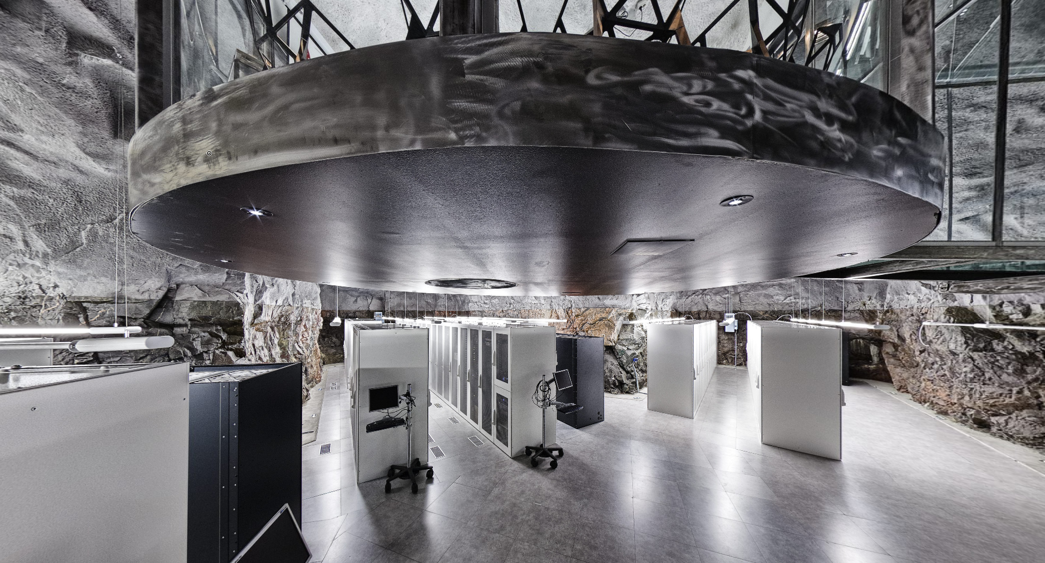

Slide 8





Slide 9
Conspiracy & Stories

Slide 10
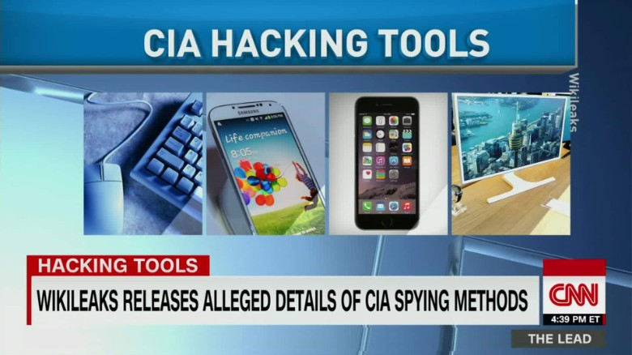

CIA Spying Scandal

Slide 11
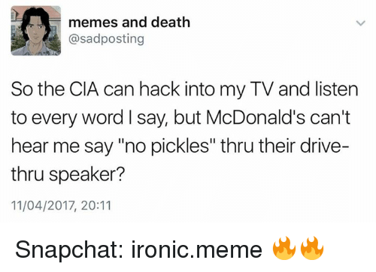

Slide 12
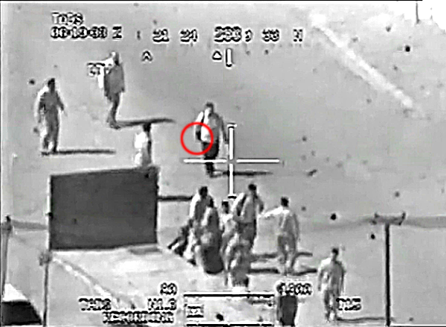
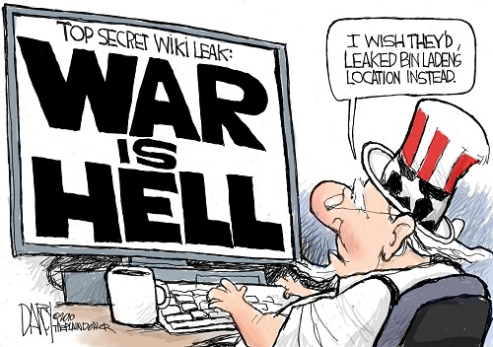
Collateral Murder

Slide 13
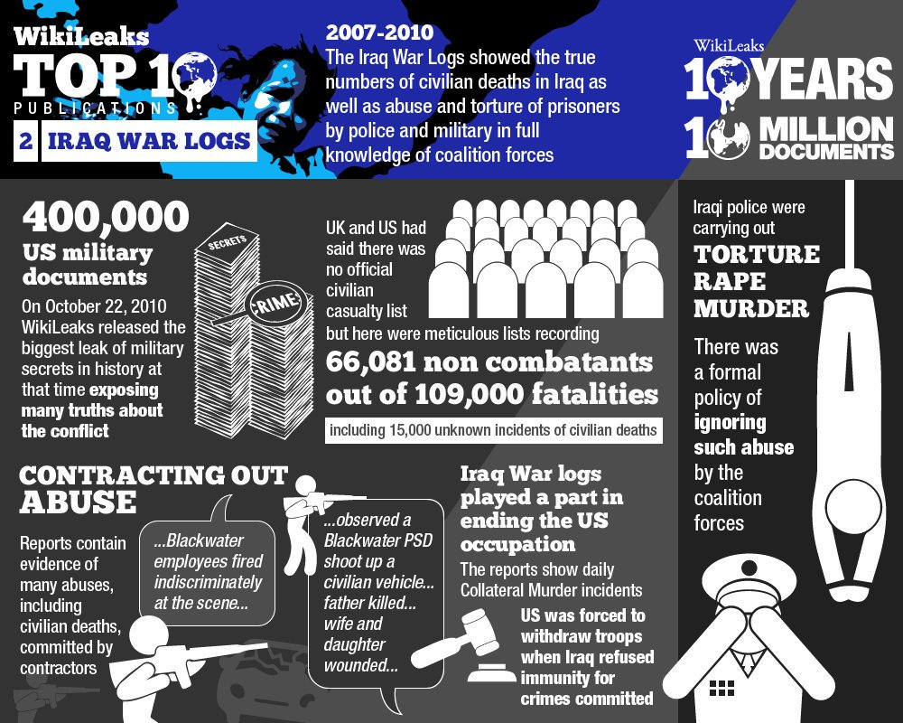

Slide 14
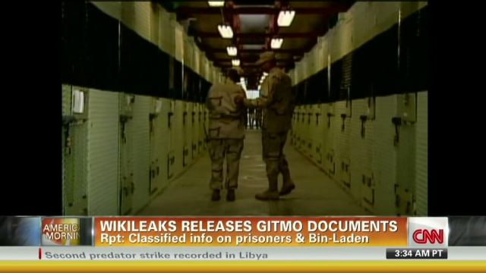
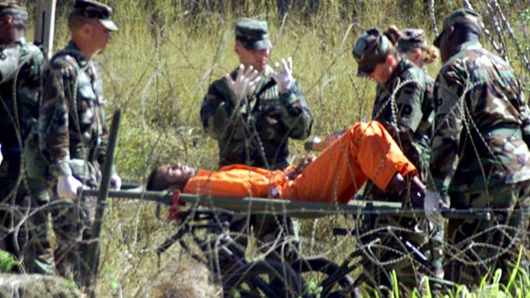
Guantanamo Prison

Slide 15
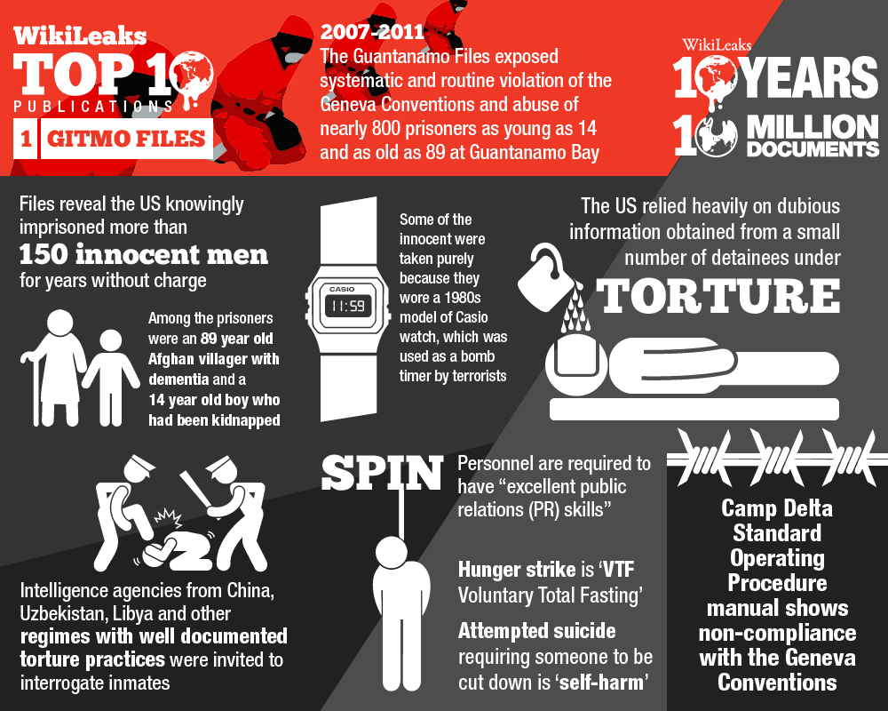

Slide 16
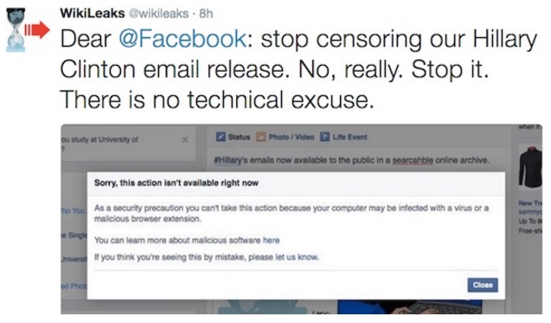
Hillary’s Emails

Slide 17
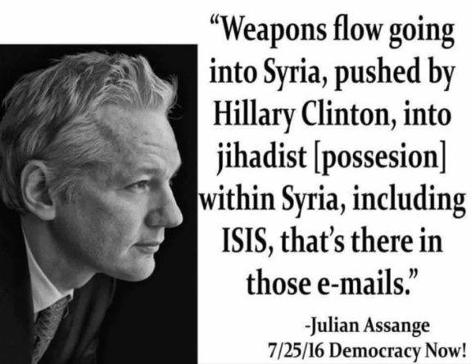

Slide 18
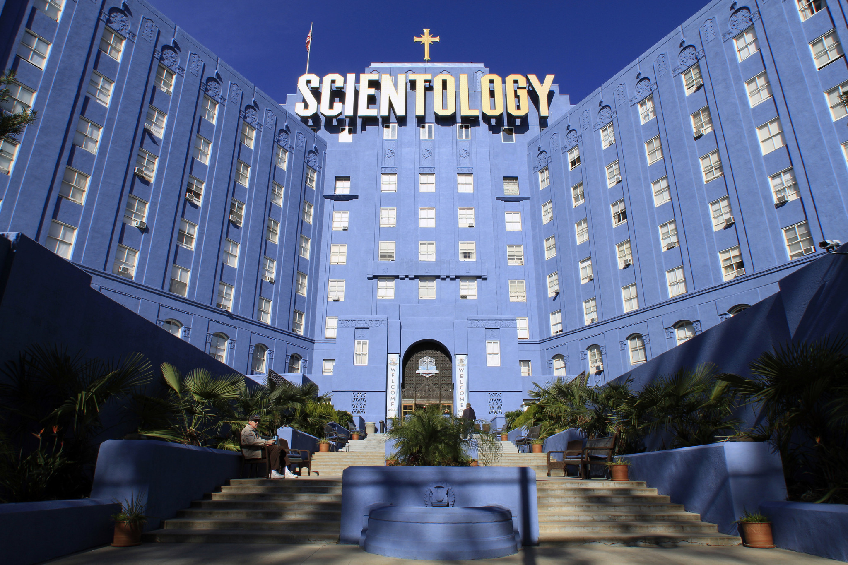
Scientology Files

Slide 19
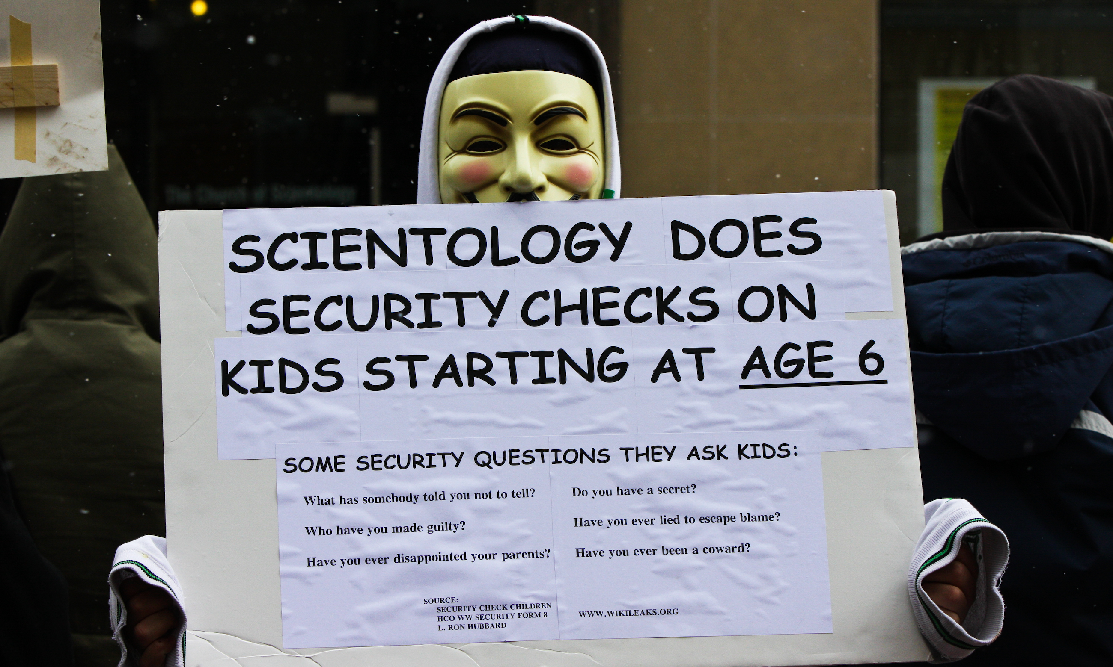

Slide 20
